Slide 1
Transmission Control Protocol
Presented By:
Sabin Nepal
Rajan Bhattarai
Achut Dahal
Aruna Shrestha

Slide 2
Table of content
Introduction to TCP
Features of TCP
TCP header
Connection management

Slide 3
Introduction to TCP
A reliable, connection-oriented transport protocol
protocol for data transmission in communication network such as internet
provides a reliable stream delivery and connection service to applications
corresponds to the transport layer of TCP/IP suite
Used in World Wide Web (WWW),E-mail, File Transfer Protocol, Secure Shell, peer-to-peer file sharing, and some streaming media applications.

Slide 4
Features
Reliable protocol
Connection-oriented
provides error-checking and recovery mechanism
end-to-end communication.
provides flow control and quality of service.
operates in Client/Server point-to-point mode
provides full duplex server

Slide 5
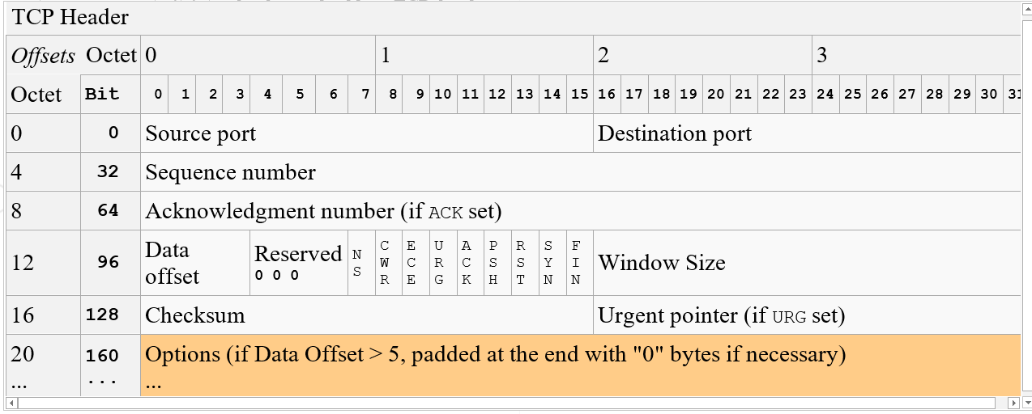
TCP header

Slide 6
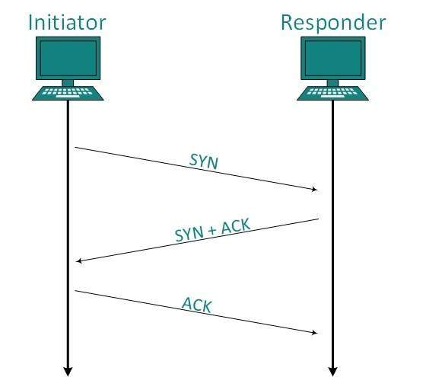
Connection Management
works in Server/Client model
client initiates the connection
and the server either accepts or rejects it
Three-way handshaking is used for
connection management

Slide 7
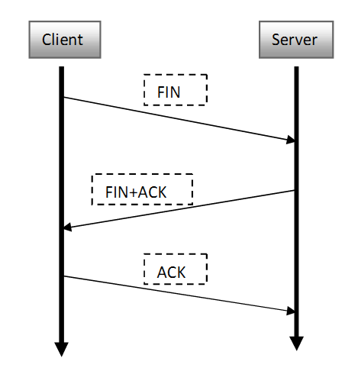
Connection termination

Slide 8
References
https://www.tutorialspoint.com/data_communication_computer_network/transmission_control_protocol.htm
https://www.slideshare.net/k33a/transmission-control-protocol-tcp-31902778
https://www.slideshare.net/k33a/transmission-control-protocol-tcp-31902778

